Slide 1
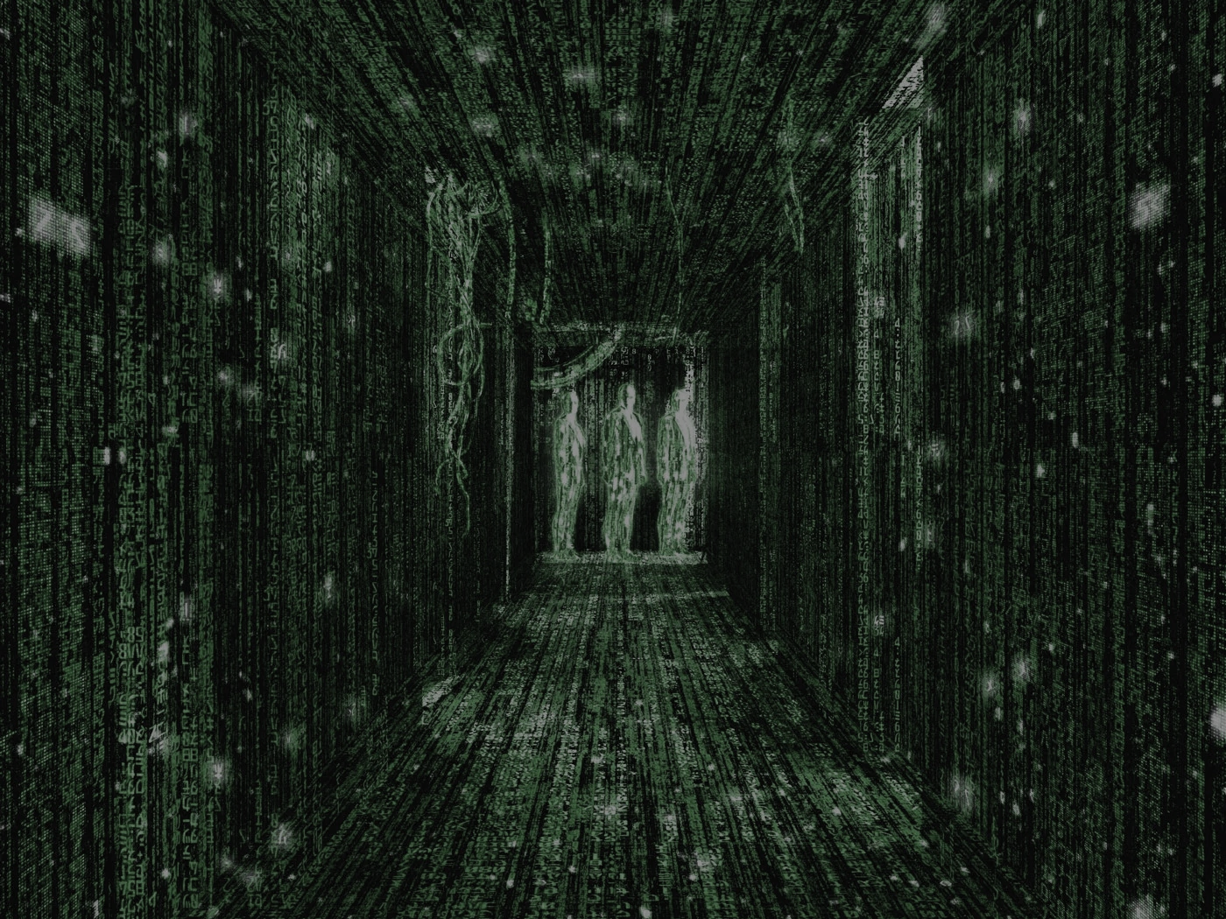

Session #2:
How computers work?
What computers are good at?
Programming languages
C# Programming language
Installing Visual Studio.
Our first C# program.

Slide 2
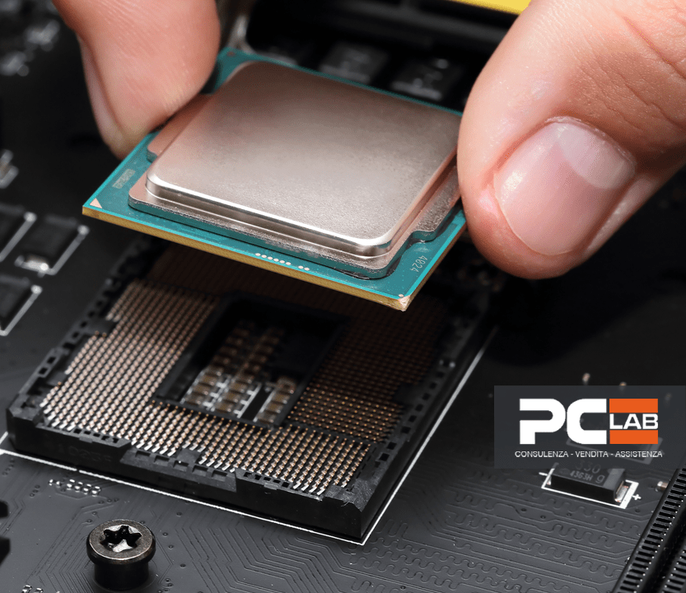
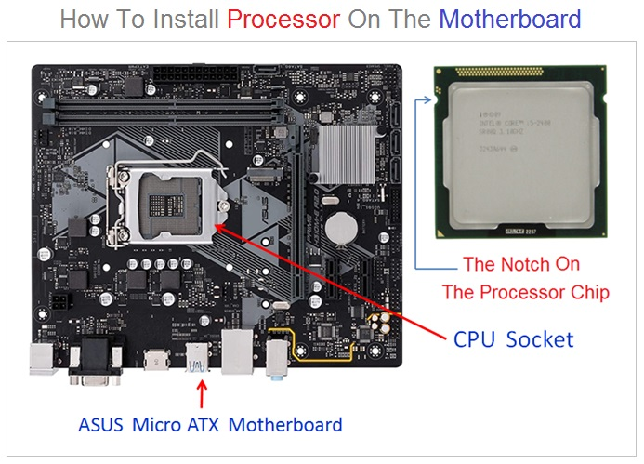
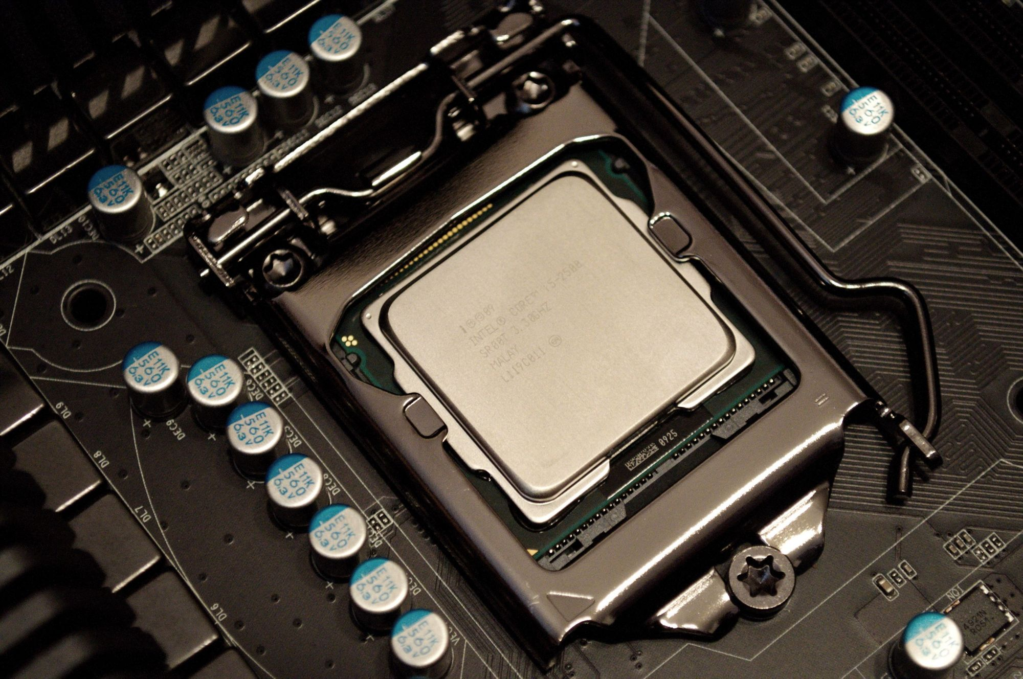
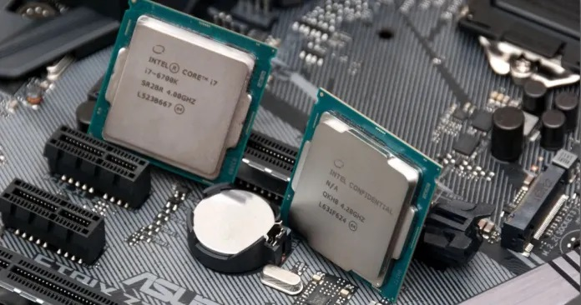
How Computer works?

Slide 3
We Better Work Together
What Computers are good at?
Computers are better than humans at:
Performing repetitive and tedious tasks quickly and accurately.
Processing and storing vast amounts of data at high speeds.
Performing complex calculations and simulations.
Analyzing and recognizing patterns in large datasets.
Completing tasks without getting bored, tired, or distracted.
Executing precise and consistent instructions without errors.
Managing and controlling automated systems.
We are good at?
On the other hand, humans are still better than computers at:
Creativity and innovation, such as in art, music, writing, and design.
Understanding and processing ambiguous or incomplete information.
Learning and adapting to new situations.
Emotional intelligence and empathy.
Complex problem-solving that requires intuition and judgment.
Critical thinking and decision-making in unpredictable situations.
Social interaction and communication.

Slide 4
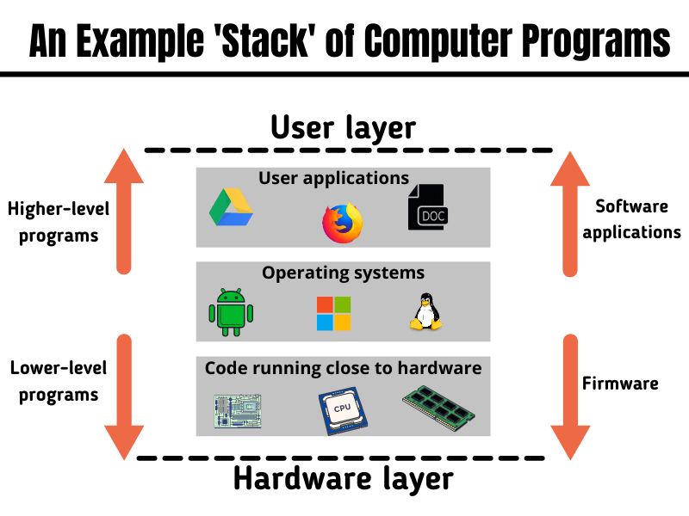
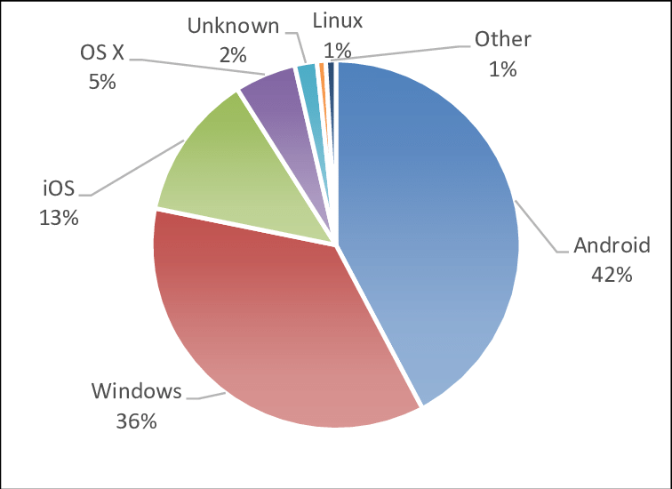
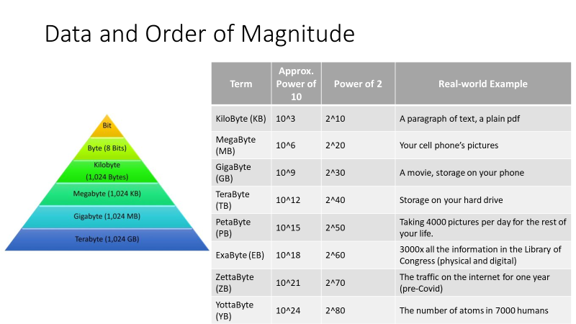
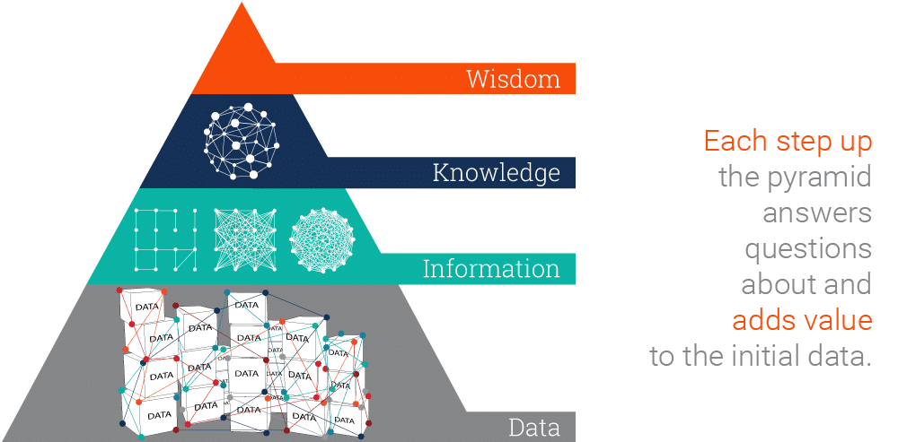
Some Basic Computer Science
Hardware
Software
Data, Information, Knowledge and Wisdom
Operating System

Slide 5
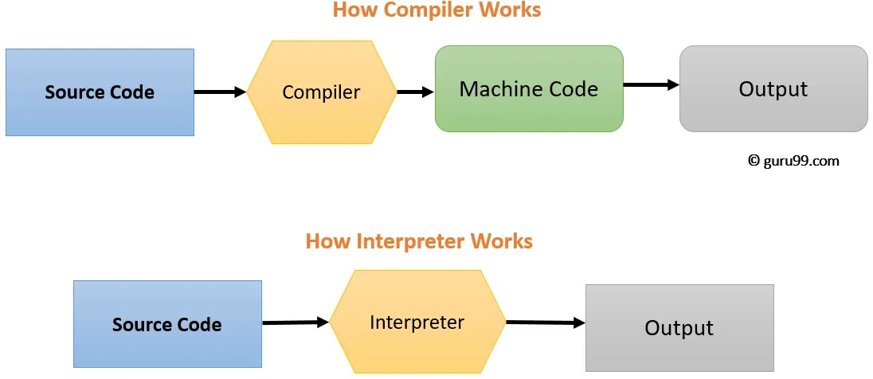
Programming Language
Machine and Assembly Language
C/C++, Pascal, Modula2
Basic, Java, C#, Python, javaScript …
Compiler vs Interpreter

Slide 6
C# language
Installing Visual Studio
Hello world program

